Slide 1

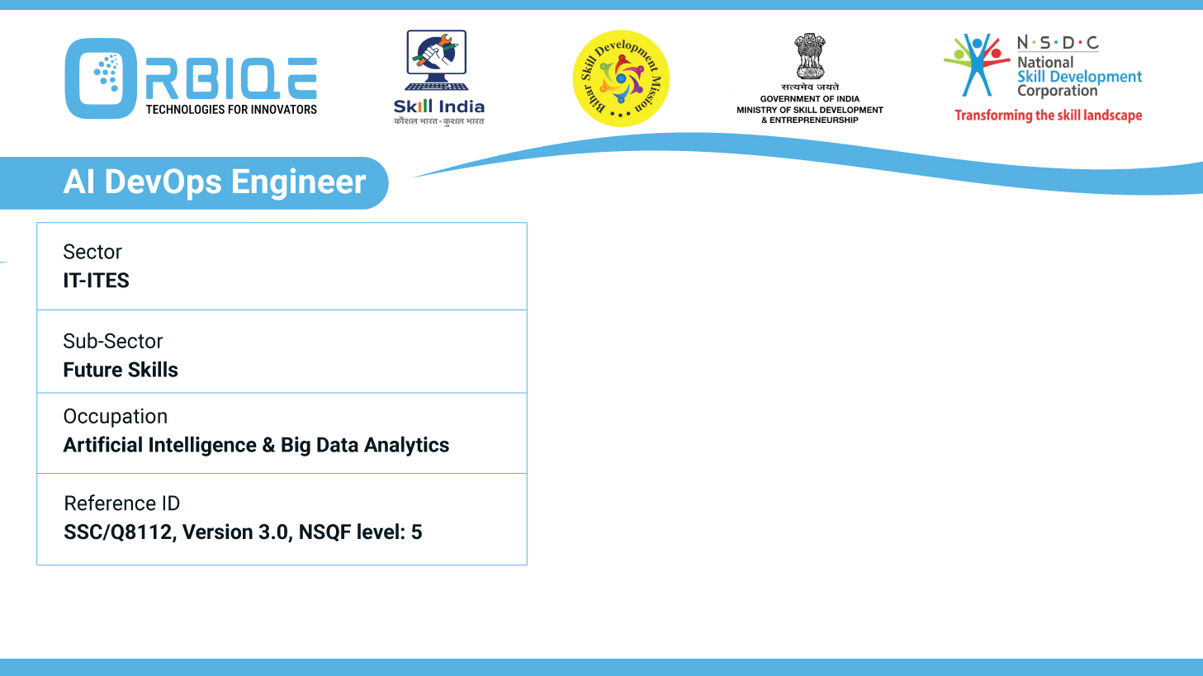
Name- Krishna Kant Dubey

Slide 2

Setting up Master-Agent Architecture with Puppet

Slide 3
Agenda
Install Puppet master on a centralized server and Puppet agent on client nodes
Configure Puppet master to manage agent nodes and distribute configurations
Define manifests and apply them to agent nodes to enforce desired configurations

Slide 4
Install Puppet master on a centralized server and Puppet agent on client nodes

Slide 5
Configure Puppet master to manage agent nodes and distribute configurations

Slide 6
Define manifests and apply them to agent nodes to enforce desired configurations

Slide 7
Thank You

